Slide 1
Machine Translation Project French-English Translation Using Multiple Neural Networks
Team Members:
Gattupalli Veera swamy
Sutharsanan Sampath
Selva Vigneshwar Amuthan

Slide 2
Project Overview
In this project we focused on French-to-English translation using multiple neural network architectures:
Encoder-Decoder model
Encode –Decoder with Attention model
Encode –Decoder with Multi Headed Attention model
Transformer model

Slide 3
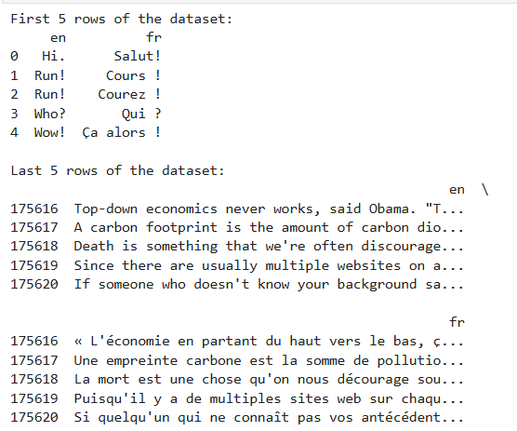
Dataset Overview
This is a French-English parallel corpus used from manythings.org
Dataset Link : https://www.manythings.org/anki/
Number of Sentences: 175622 sentence pairs.
Sample data:

Slide 4
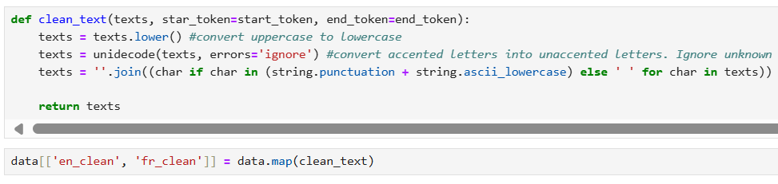
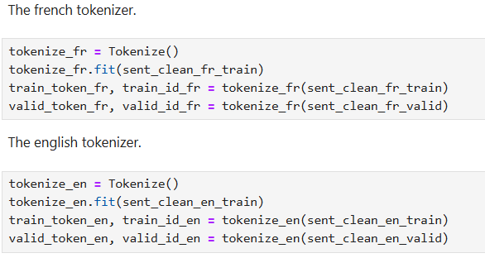
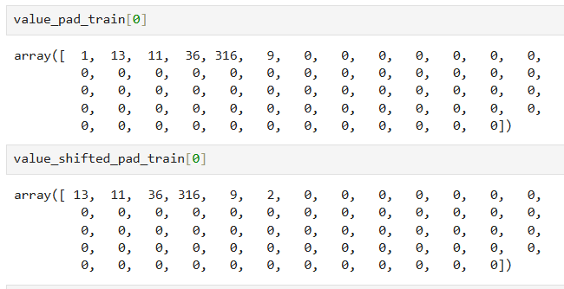
Data Preprocessing
Preprocessing Steps:
Data cleaning like lowercasing, removal of special characters
Tokenization.
Padding sequences to ensure uniform input length.

Slide 5
Dataset Split
Challenges with the Dataset:
Handling rare words and managing the alignment between source and target sentences of varying lengths.
Data Split:
80% for training, 10% for validation, and 10% for testing

Slide 6
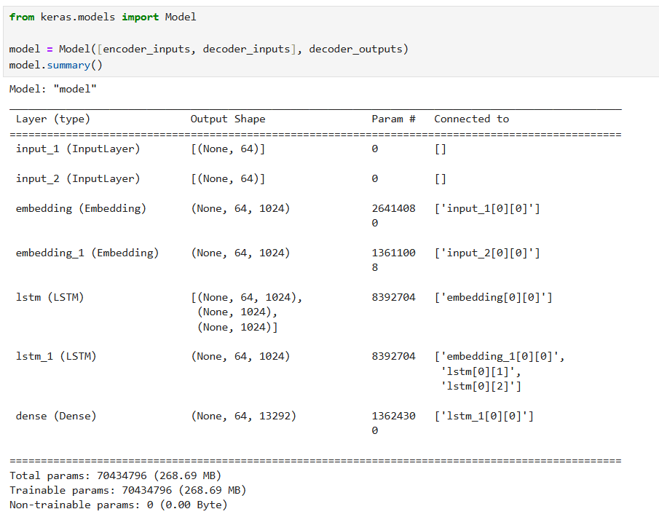
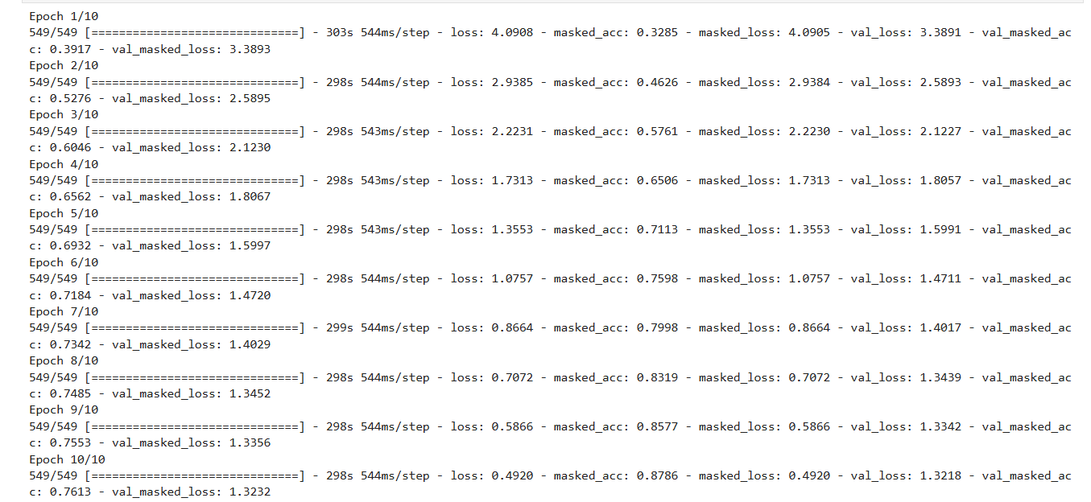
First Model(Encoder-Decoder)
This is a basic encode-decoder model with following used parameters
UNITS = 1024
EPOCHS = 10
BATCH_SIZE = 256
Optimizer = Adam

Slide 7
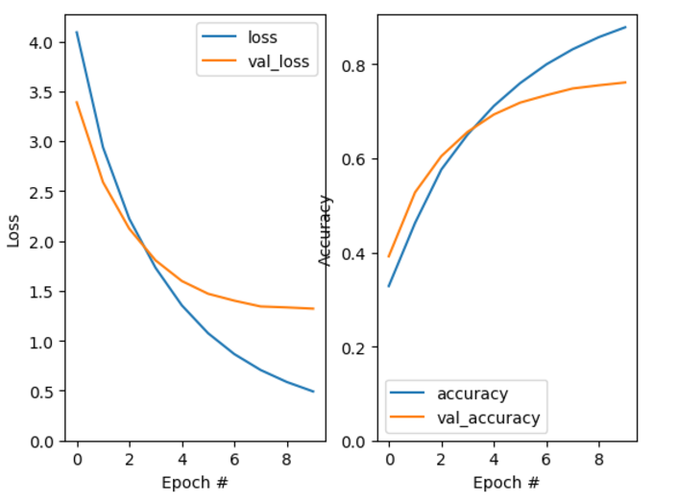
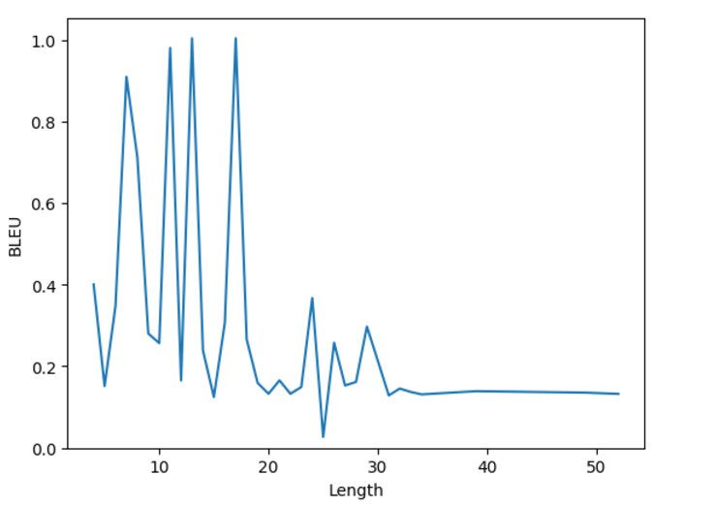
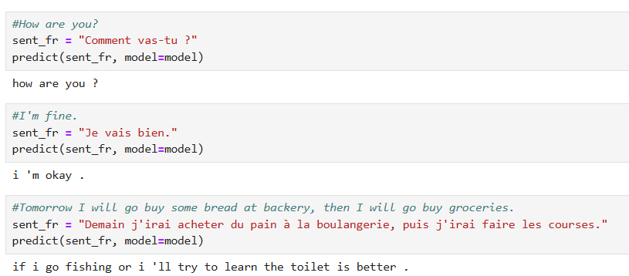
Result & translations
Accuracy & loss plot
Blue Score
Text Example

Slide 8
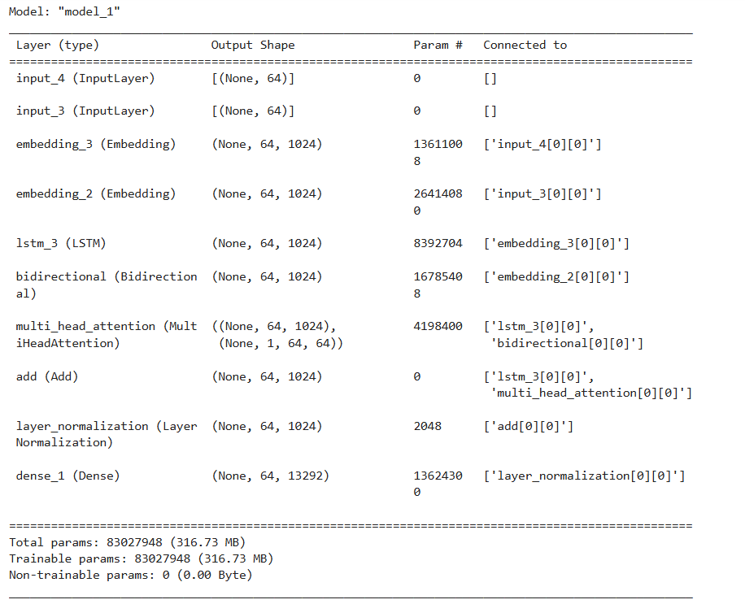
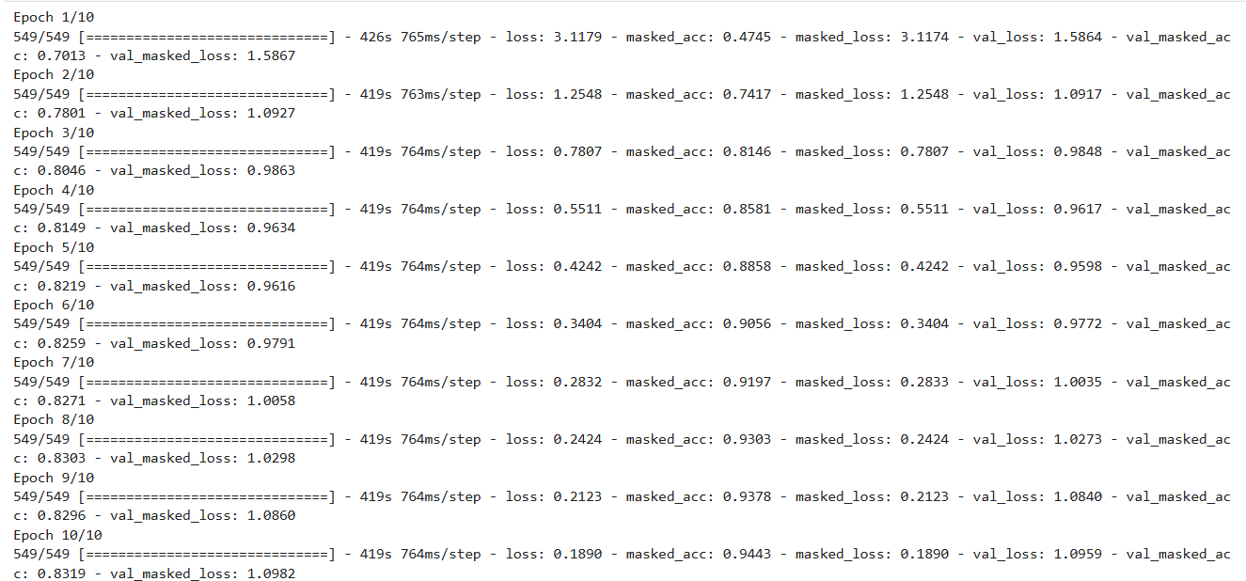
Second Model (Encoder - Decoder - Attention)
This is the model with attention

Slide 9
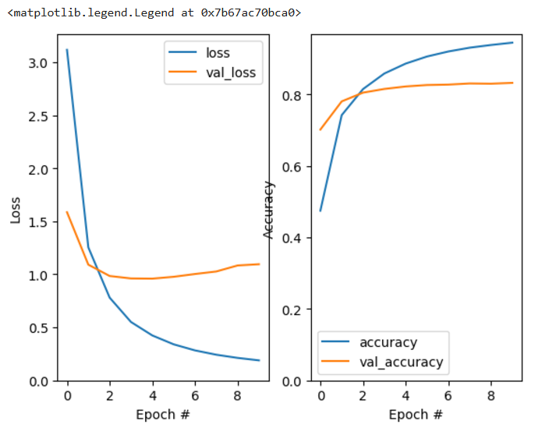
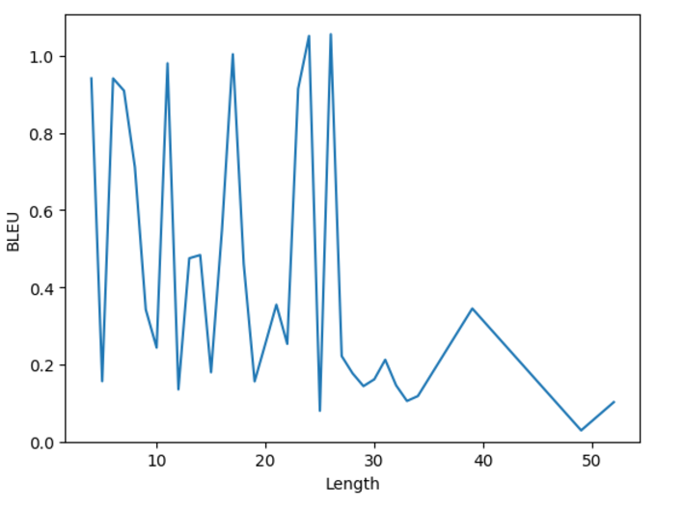
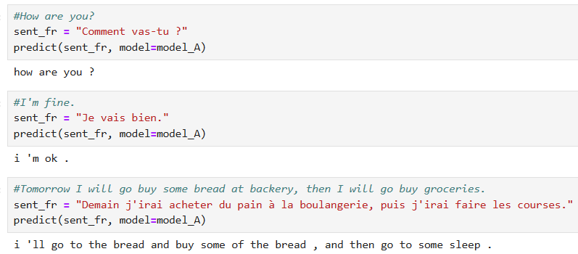
Results & translations
Accuracy & loss plot
Blue Score
Text Example

Slide 10
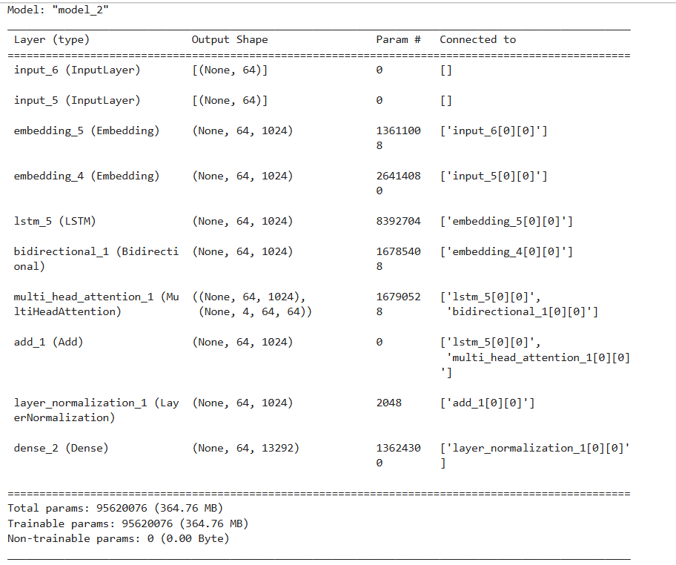
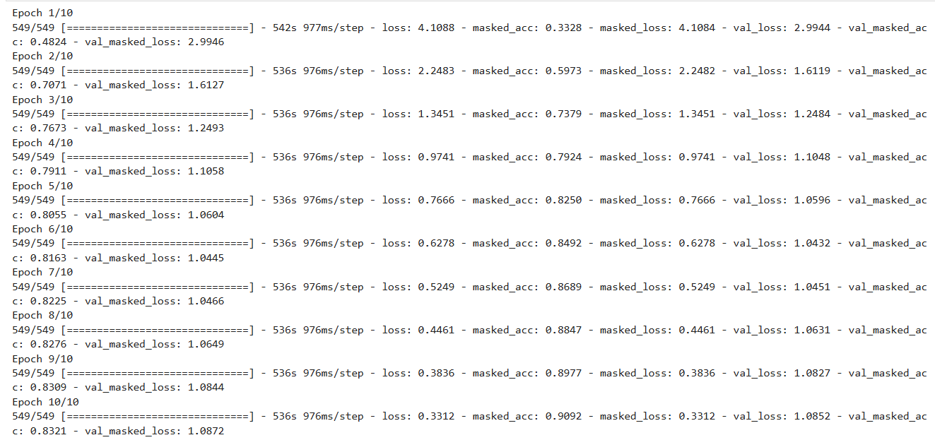
Third Model (Encoder - Decoder - Multi Headed Attention)
This with multi headed attention

Slide 11
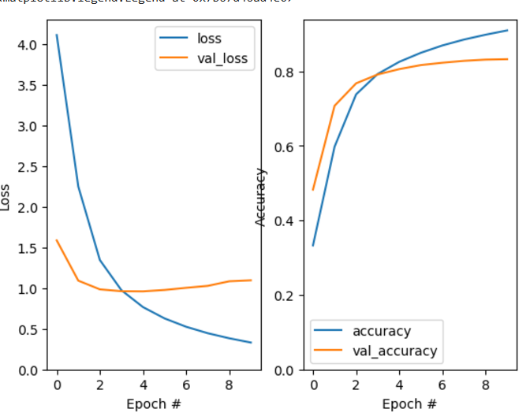
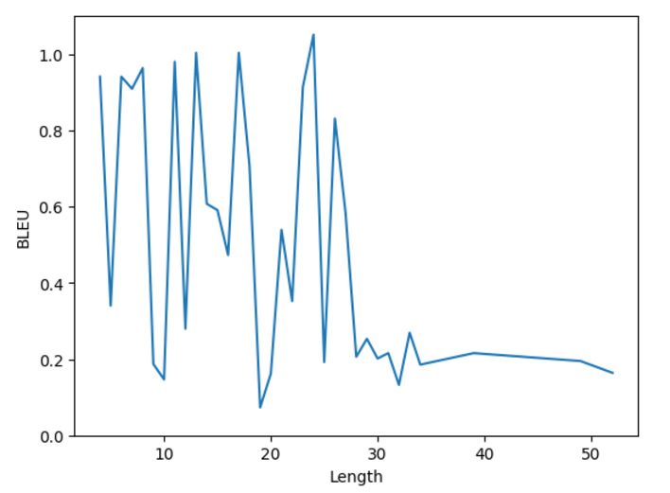
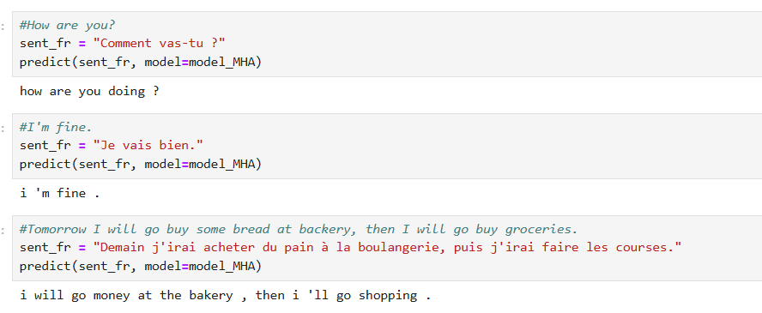
Result & translation
Accuracy & loss plot
Blue Score
Text Example

Slide 12
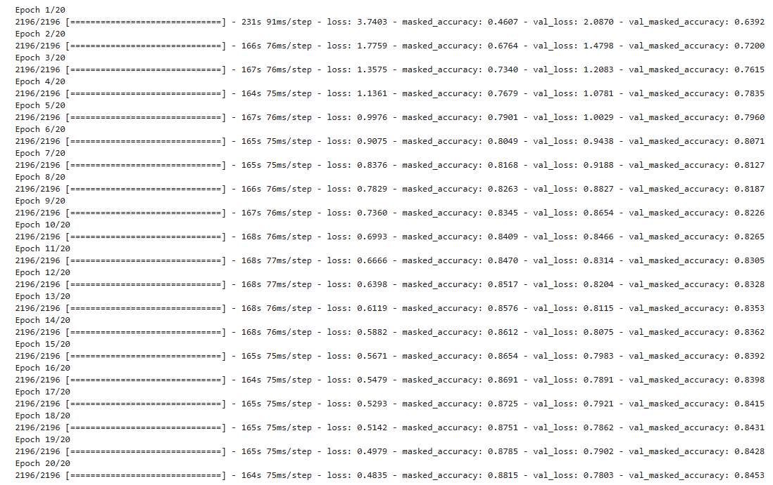
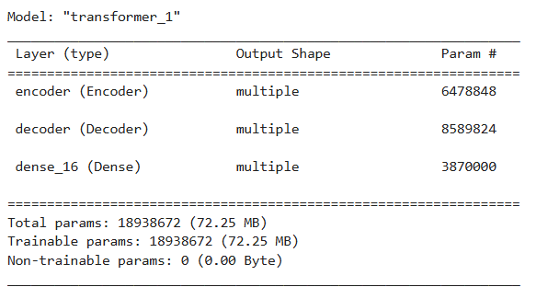
Fourth Model (Transformer)
Here are the Transformer model parameters
num_layers = 4
d_model = 128
dff = 512
num_heads = 8
dropout_rate = 0.1
Optimizer = Adam

Slide 13
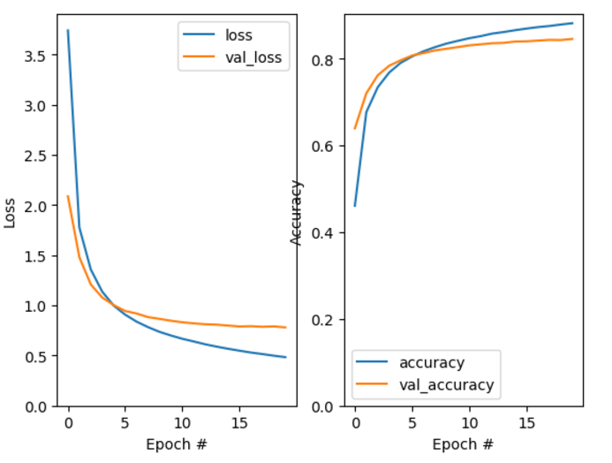
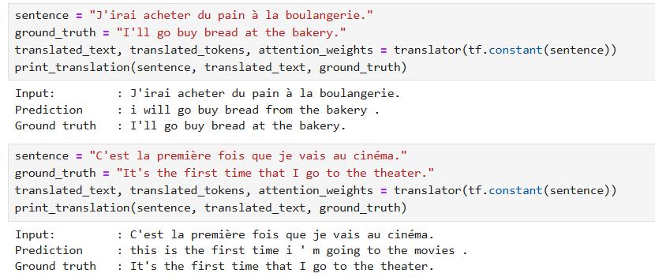
Result & translation

Slide 14

Conclusion
All models performed well. However, in terms of translation quality, the Transformer model stood out as it produced translations that were much more accurate and contextually relevant than the Multi-Head Attention model. On the other hand, in terms of accuracy, loss, and BLEU scores, the Multi-Head Attention model outperformed the other models, yielding better overall results in those metrics.

